Slide 1
Turbulent Times for German Aviation Employees and their Representatives – the Ryanair Saga Michael Doherty & Michael Whittall

Slide 2
Structure
Viral Project
The Ryanair Business Model
Liberalization of the German Aviation Industry
Lufthansa – fighting an Unlevel Playing Field
Industrial Relations Landscape in the German Aviation Industry
Rolling back the Roll Back – a Silver Lining?
Discussion

Slide 3
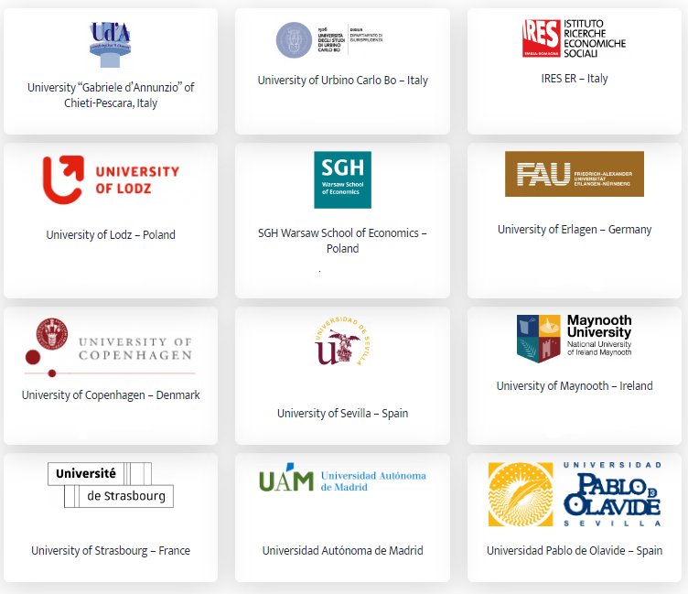
Viral Project

Slide 4
Viral Project
Objectives
analysis and research in a crucial European business, particularly affected by the Covid-19 pandemic, such as the air transport sector and its value chain.
The role of Industrial Relations and the support that governments intend to give to address employment problems and deteriorating working conditions in the sector in view of its reorganisation.

Slide 5
Viral Project
Objectives
the effect of the Covid-19 pandemic on employment levels as well as working conditions in the sector. …different measures and procedures undertaken for its short- (during the lockdown) and long-term (post-lockdown) future, ….considering technological and environmental challenges.
The role of the various national industrial relations systems in mitigating the short-term effect of Covid-19 and in the ‘relaunching’ of the European air transport value chain

Slide 6
Viral Project
Objectives
Work Package 2 = Market Developments in the Aviation Industry
Work Package 3 = Industrial Relations Developments in the Aviation Industry

Slide 7
Viral Project
Since 1996, the EU Commission has undertaken massive efforts to make the aviation market cheaper… I have to be honest… To achieve this, it has been necessary to privatize the flag carriers. That was carried out. The people who were employed by Lufthansa used to be civil servants or had civil servant-like status. This was all transferred to the private sector and all these rights were, so to speak, dismantled. Then came the other step in the last 20 years, namely the liberalization of ground services and airports, which in my view are extremely critical infrastructures, but nevertheless this instrument of market liberalization was mistakenly applied there as well. ……………….

Slide 8
Viral Project
……………..As a result, a large part of the air traffic infrastructure has been massively damaged, quality has been seriously reduced, employee rights have been massively restricted, and incomes and social standards in air traffic have deteriorated massively… both in terms of ground services, pilots and flight attendants. (Ver.di union officer)

Slide 9
The Ryanair Business Model
START
RELAUNCH
Est 1985 (to compete with legacy airlines on UK routes)
“low-cost/
No frills”
Study Southwest Airlines, Dallas, USA
high passenger- staff member ratio
1990- losses of £20m
Outsourcing (catering, aircraft maintenance)

Slide 10
The Ryanair Business Model
PRECARIOUS SKIES
Staff ‘multi-task’ (e.g. clean)
Staff pay for uniforms,
etc.
(mobile phone charging)
Commission
for inflight sales
Training
costs
Pilots self-employed
Cabin-crew agencies

Slide 11
The Ryanair Business Model
Remember me?

Slide 12
The Ryanair Business Model
ENEMIES OF THE FREE MARKET
European Commission
“Morons”
Travel Agents:
“Should be taken out and shot”
British Airways:
“Expensive Bas…… “
Trade Unions:
“%$%%$$”

Slide 13
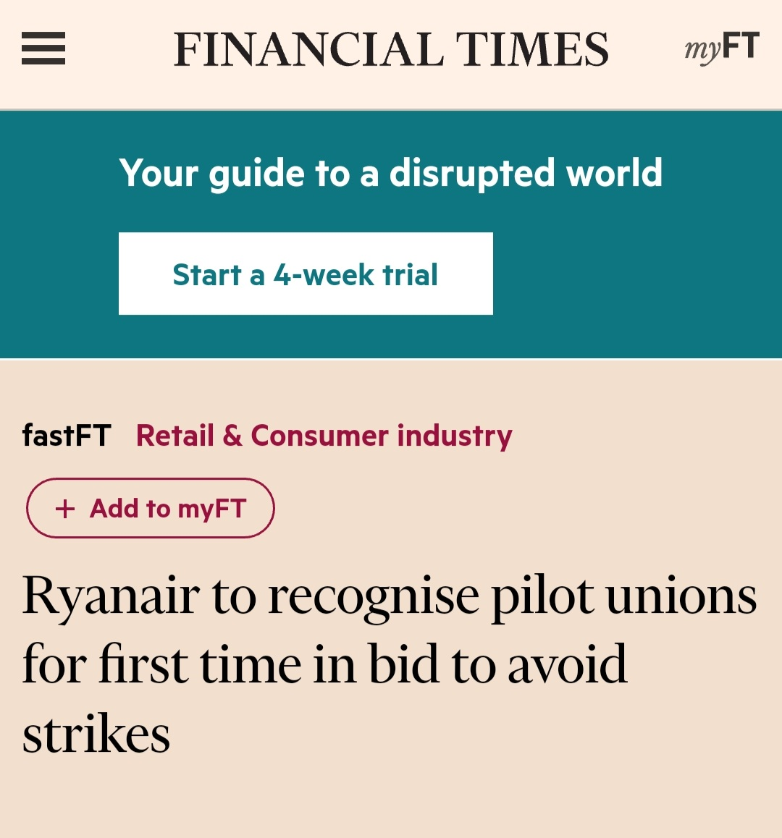
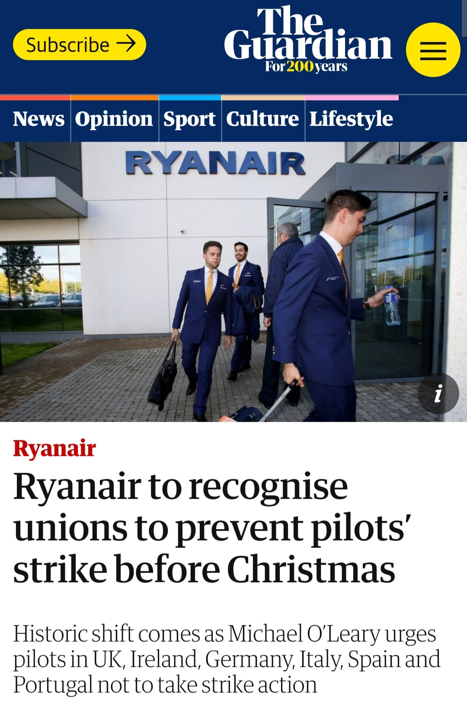
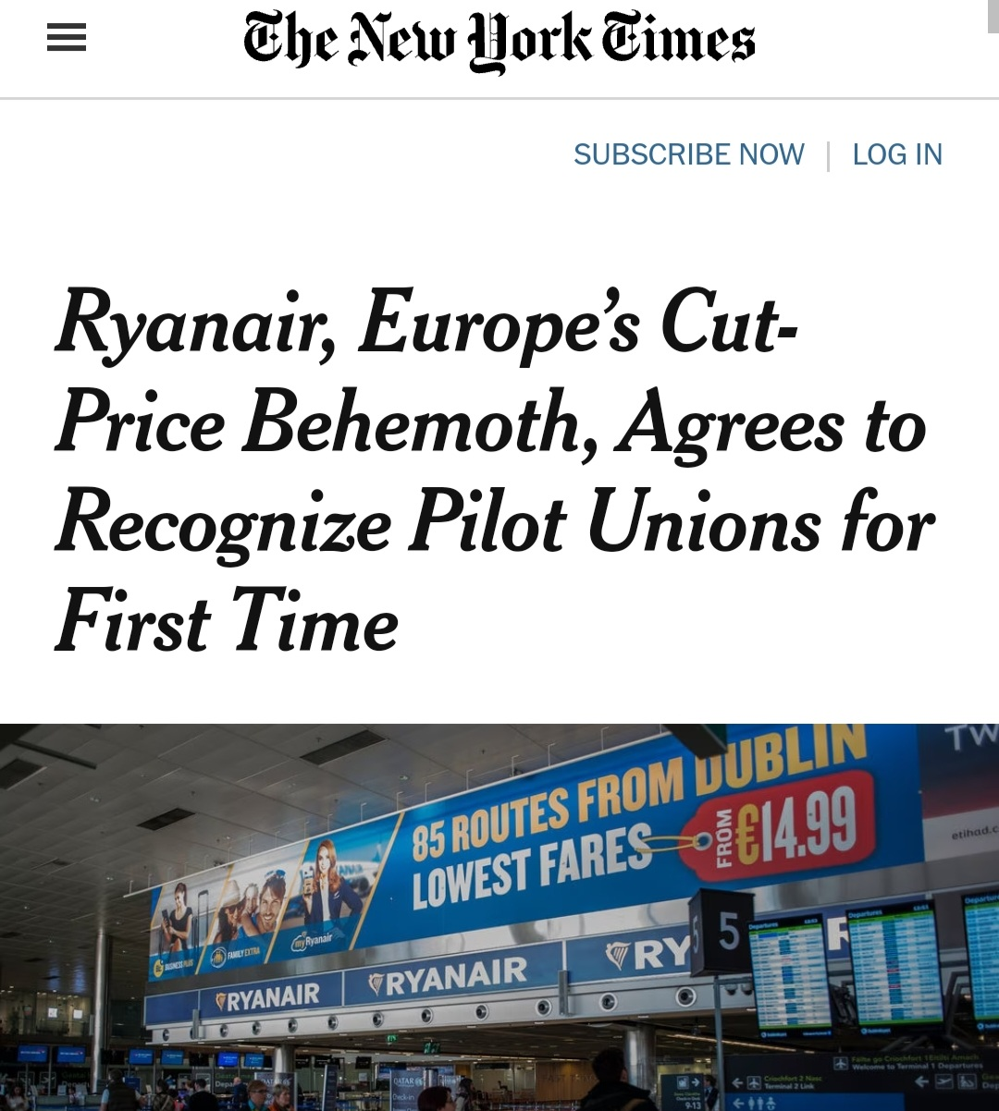
The Ryanair Business Model
threat of strike action and co-ordinated trade union action across EU in 2017….

Slide 14
Liberalization of the German Aviation Industry
Number of passengers from German airports 2001-2021

Slide 15
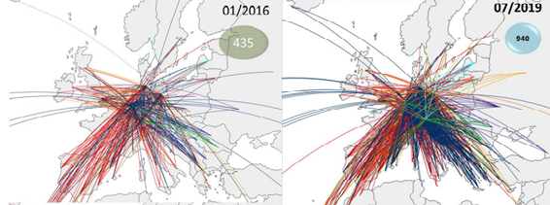
Liberalization of the German Aviation Industry
The development of low cost routes from Germany

Slide 16
Liberalization of the German Aviation Industry
Percentage of LCC Starts at German Airports

Slide 17
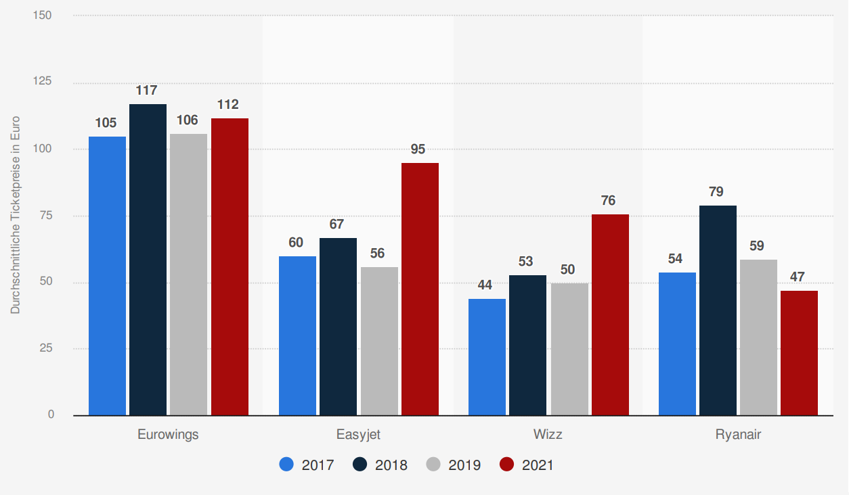
Liberalization of the German Aviation Industry
The Average Ticket Price of Low Cost Carriers

Slide 18
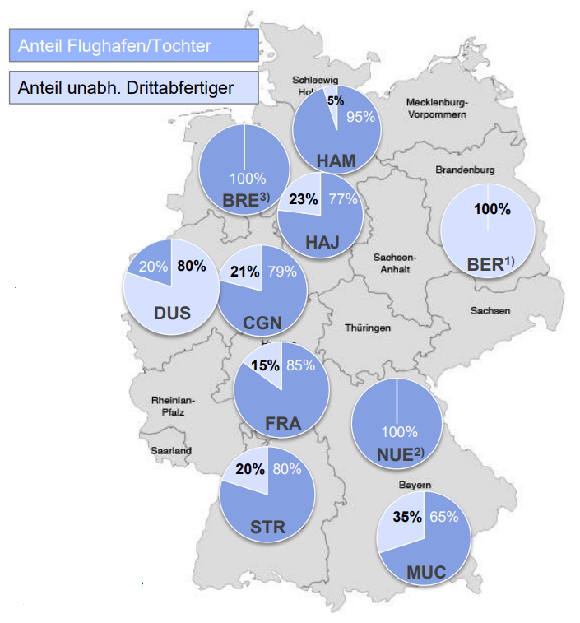
Liberalization of the German Aviation Industry
The percentage of third party ground-handing services at German airports

Slide 19
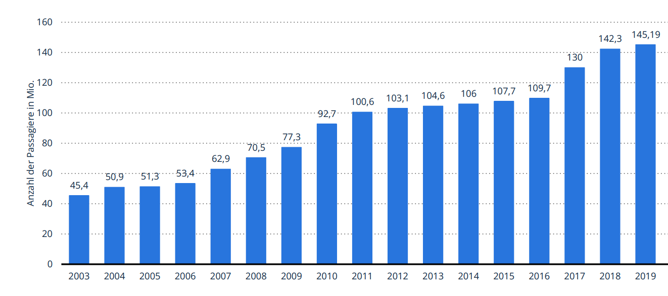
Lufthansa Group – fighting an unlevel playing field
Passengers Flying with the Lufthansa Group 2003-2019

Slide 20
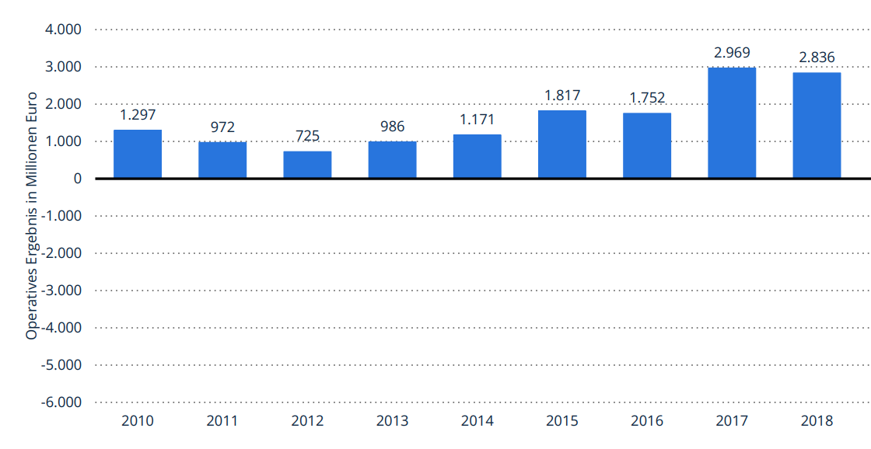
Lufthansa Group – fighting an unlevel playing field
Adjusted EBIT 2010-2018

Slide 21
Lufthansa Group – fighting an unlevel playing field
Network Airlines – Shopping Frenzy
Lufthansa SWISS Austrian Brussels

Slide 22
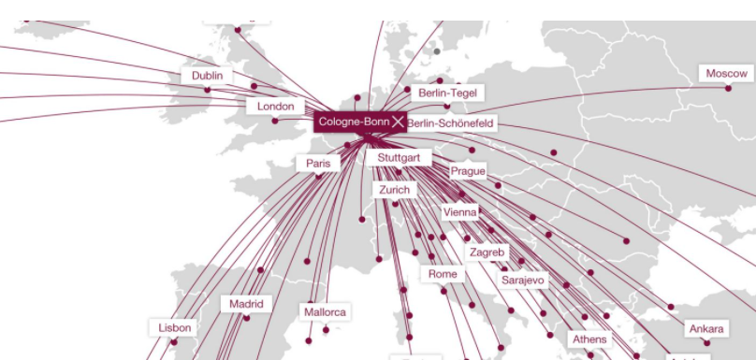
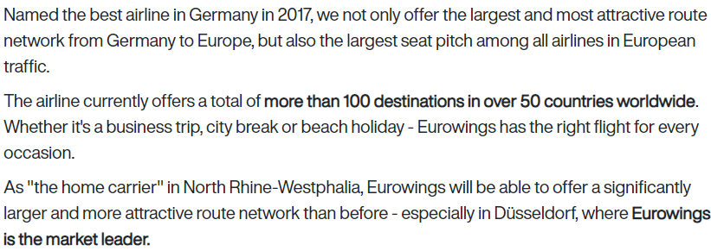
Lufthansa Group – fighting an unlevel playing field
Low Cost Carrier Strategy - Eurowings

Slide 23
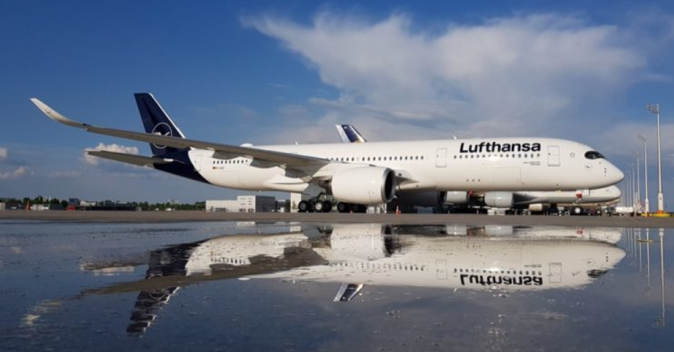
Lufthansa Group – fighting an unlevel playing field
Low Cost Carrier Strategy - Wet & Dry Leasing

Slide 24
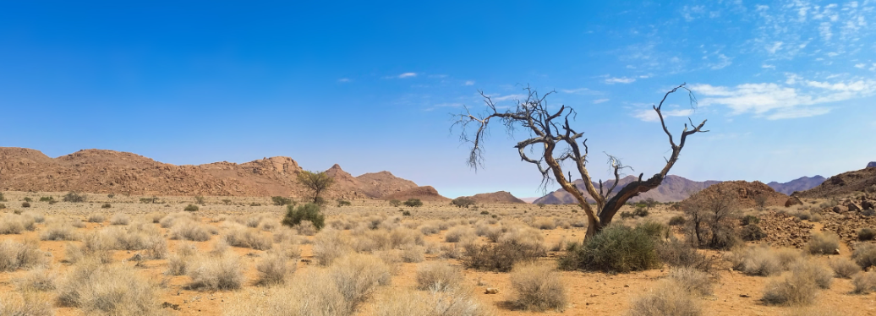
Industrial Relations Landscape in the German Aviation Industry
Modell Deutschland
Collective Bargaining
(Branch)
Social Partnership
Culture
MD Light
(Legacy airlines)
Collective Bargaining
(Company)
Conflict
Multiunionism
Strong WC in FC-Weak in LCC
One Union One Site
Strong Works Council Presence
Collective Bargaining
(high)
Collective Bargaining
(low)
Wasteland
(Low Cost Carriers)

Slide 25
Industrial Relations Landscape in the German Aviation Industry
Modell Deutschland Light
Lufthansa Group
15 different collective agreements for cabin personnel
Lufthansa Capitan
(220,000 Euro)
Eurowings Capitan
(160,000 Euro)
Ground handling
Outsourcing
Social dumping
(Minimum wage)
Sub,
sub, subcontractor
(100s of agreements)

Slide 26
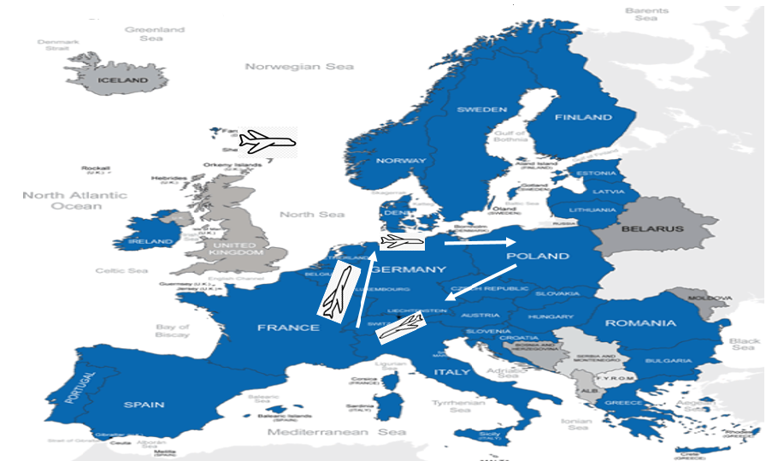
Industrial Relations Landscape in the German Aviation Industry
Wasteland – Homebase Principle

Slide 27
Industrial Relations Landscape in the German Aviation Industry
Wasteland – Homebase Principle
So, I can, as it were, under the European freedom of movement of workers, I can [employer] say: 'You live in Berlin, but we hire you in the Warsaw office or flight operations in Warsaw… You can move to Warsaw or you can just come to Warsaw before you start work, get on the plane to Hamburg as a passenger and then start your job in the cockpit in Hamburg.' Then I might have a Polish employment contract and not a German one… [T]he homebase regulation… will be our next big battle and a big challenge... In Poland, they have very liberal regulations for the self-employed, bogus self-employment is not as regulated there, as it is here [Germany]. (VC union officer)

Slide 28
Rolling back the Roll Back – a Silver Cloud
Amending the Works Constitution Act | Industrial Action within the Lufthansa Group
Branch Level Collective Bargaining for Ground Handling Staff | Breakthrough at Ryanair

Slide 29
Thank your for your attention!

